Slide 1
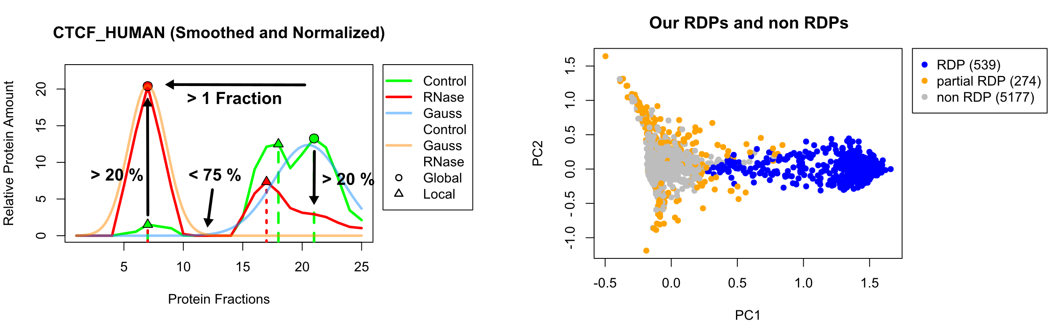
Biological Background • Methods • Results • Outlook
09
Application of Selection Criteria
Proteome-wide Screen for RNA-dependent Proteins I Team 3: HeLa Cells Synchronized in Interphase I Summer Term 2023 I 19.07.2023 I Supervisor: Dr. Maïwen Caudron-Herger

Slide 2
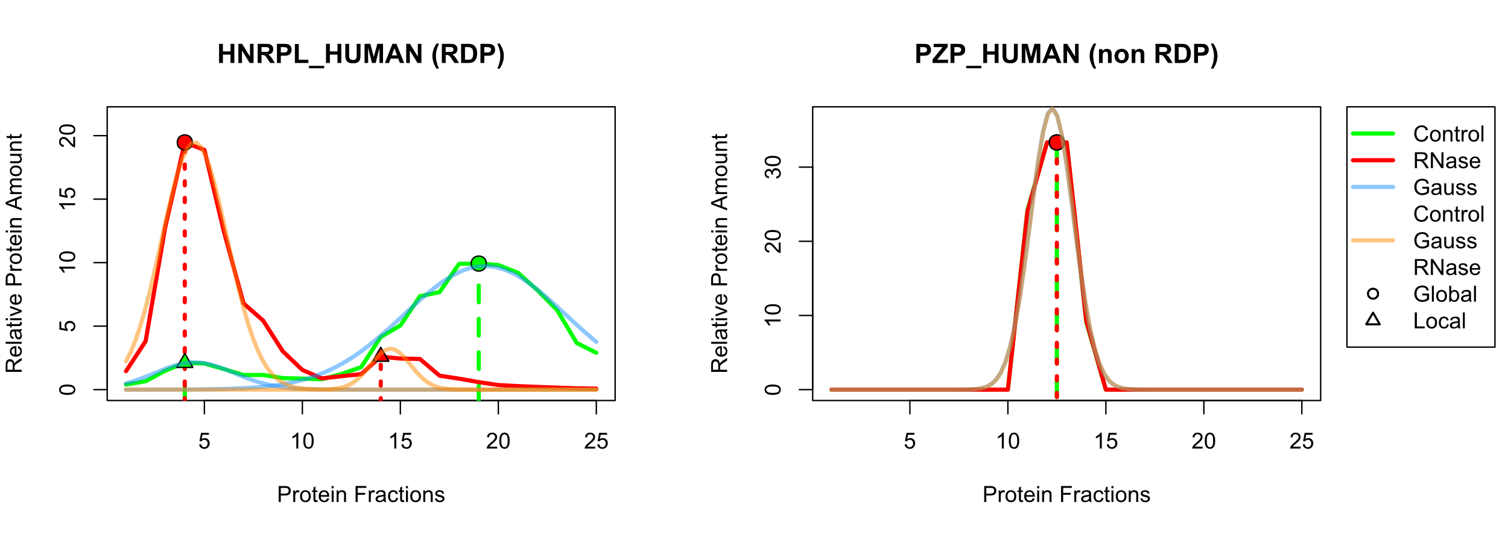
Biological Background • Methods • Results • Outlook
10
Examples for RDPs and non RDPs
Proteome-wide Screen for RNA-dependent Proteins I Team 3: HeLa Cells Synchronized in Interphase I Summer Term 2023 I 19.07.2023 I Supervisor: Dr. Maïwen Caudron-Herger

Slide 3
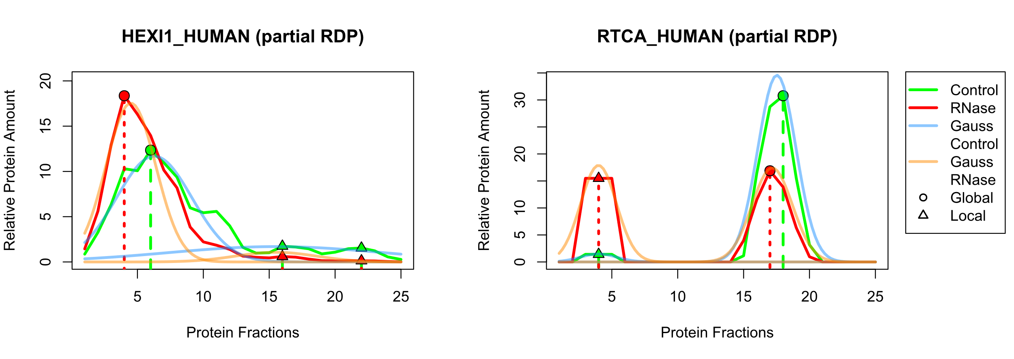
Biological Background • Methods • Results • Outlook
11
Examples for Partial RDPs
Proteome-wide Screen for RNA-dependent Proteins I Team 3: HeLa Cells Synchronized in Interphase I Summer Term 2023 I 19.07.2023 I Supervisor: Dr. Maïwen Caudron-Herger

Slide 4
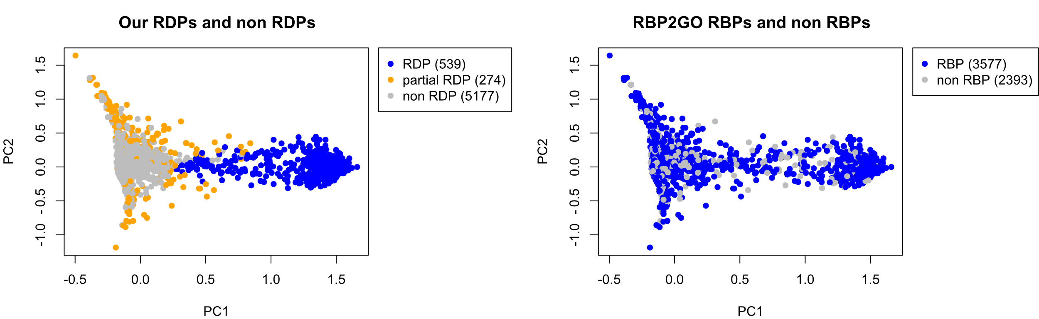
Biological Background • Methods • Results • Outlook
12
Comparison to RBP2GO
Proteome-wide Screen for RNA-dependent Proteins I Team 3: HeLa Cells Synchronized in Interphase I Summer Term 2023 I 19.07.2023 I Supervisor: Dr. Maïwen Caudron-Herger

Slide 5
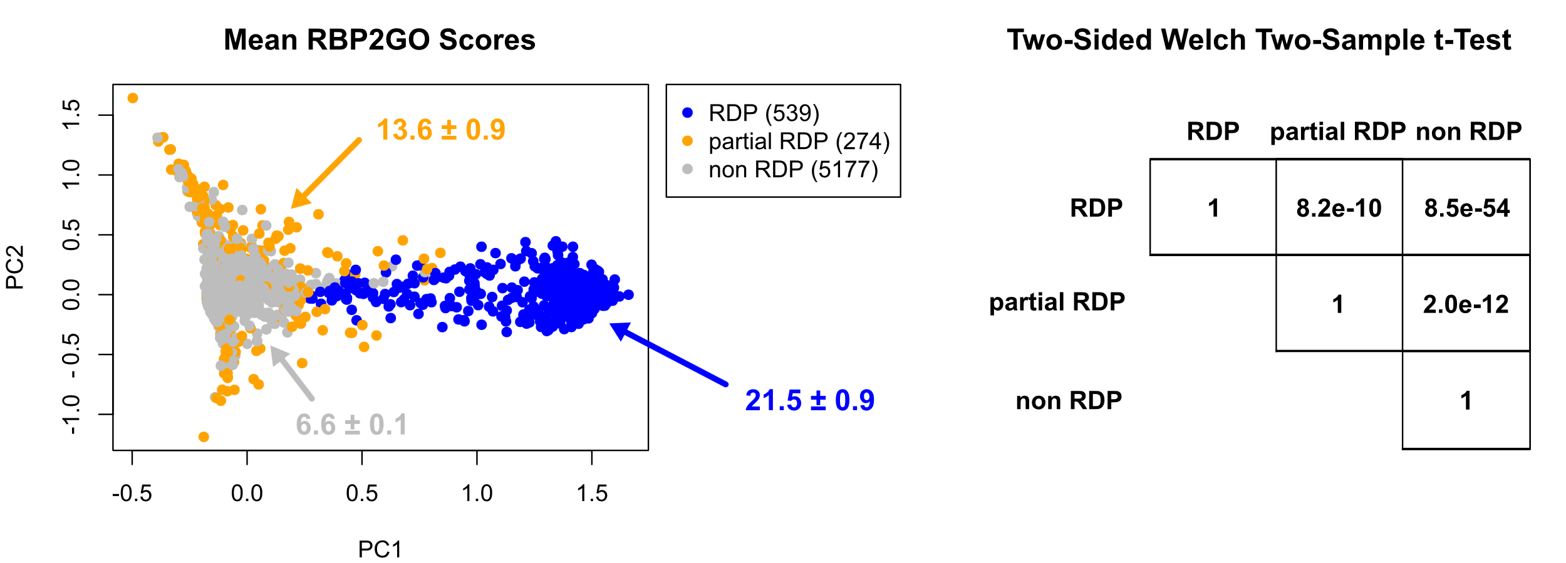
Biological Background • Methods • Results • Outlook
13
RBP2GO Score Comparison and t-Test
Proteome-wide Screen for RNA-dependent Proteins I Team 3: HeLa Cells Synchronized in Interphase I Summer Term 2023 I 19.07.2023 I Supervisor: Dr. Maïwen Caudron-Herger

Slide 6
Backup

Slide 7
Biological Background • Methods • Results • Outlook
16
# Überschrift #
# Text #
# Source #
Proteome-wide Screen for RNA-dependent Proteins I Team 3: HeLa Cells Synchronized in Interphase I Summer Term 2023 I 19.07.2023 I Supervisor: Dr. Maïwen Caudron-Herger

